Slide 1

Ansible

Slide 2
Today’s Agenda
What is Ansible
Why Ansible
Ansible Architecture & how it works
Strength of Ansible
Ansible Use Cases
Automation Tools
Installation of Ansible

Slide 3
What is Ansible?
Ansible is an Open Source Automation Tool or Platform, used for automate IT tasks, configuration management, application deployment, intra-service orchestration and provisioning.

Slide 4
Why Ansible?
Ansible is Simple
Ansible is Powerful
Ansible is Agentless
Free and Open Source
Supported by RedHat

Slide 5
Ansible Architecture
Control Node
Managed Host
Inventory
Playbook
Module

Slide 6
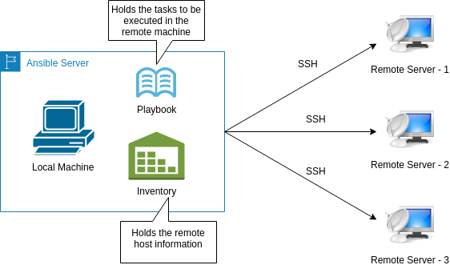

Slide 7
Strength of Ansible
Cross Platform Support
Human-readable Automation
Perfect description of application
Support dynamic Inventories
Easy to manage with version control

Slide 8
Ansible Use Cases
Configuration Management
Application Deployment
Provisoning
Continuous delivery
Security Compliance
Orchestration

Slide 9





Automation Tools
Ansible
Puppet
Chef
Salt Stack
CF Engine

Slide 10
Requirement for Installation
Contol Node----- Should be Linux or Unix
Python 2 (2.7 or later) or Python 3 (3.5 or later)
Managed Host------- Can be Linux or Unix or Window or N/w Devices
Python 2 (2.6 or later) or Python 3 (3.5 or later)

Slide 11
Installation
First of all you have to configure EPEL repository on your system.
Then:-

Slide 12
Thank You

